Slide 1

LAB 1
Use Case Modeling
5 marks
Week 14

Slide 2
Lecture Outline
LAB#1 -Use Case Modeling
1
LAB Instructions
2
LAB Assignment 3
No LAB Assignment 1 and 2
没有实验室作业 1 和 2
Notes:
Story way how did we get here?

Slide 3


Lab Instructions

Slide 4
Lab Instructions
Important Notice
Complete all lab assignments on time, May need some preparation in advance
按时完成所有实验作业，可能需要提前准备
I will collect a screenshot of the result at the end of each lab class.
我会在每个实验课结束时收集结果的屏幕截图。
Follow PPT, design doc file, and video to complete assignments.
按照PPT、设计文档文件和视频完成作业。

Slide 5
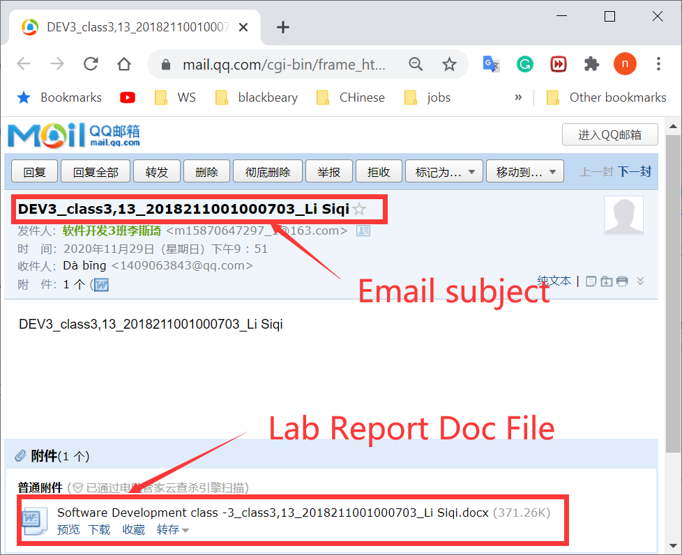
Lab Instructions
Important Notice
Prepare and Email me Lab report at the end of week 17.
在第 17 周结束时准备并通过电子邮件将实验室报告发送给我。
More details Later....

Slide 6
How to submit lab assignments?

Slide 7
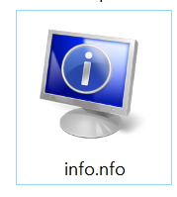
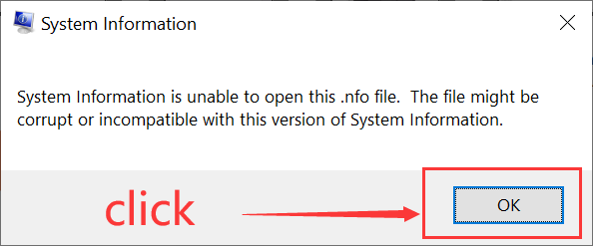
How to submit lab assignments?
Lab Instructions
Step 1 : Click info.nfo file
步骤1：单击info.nfo文件

Slide 8
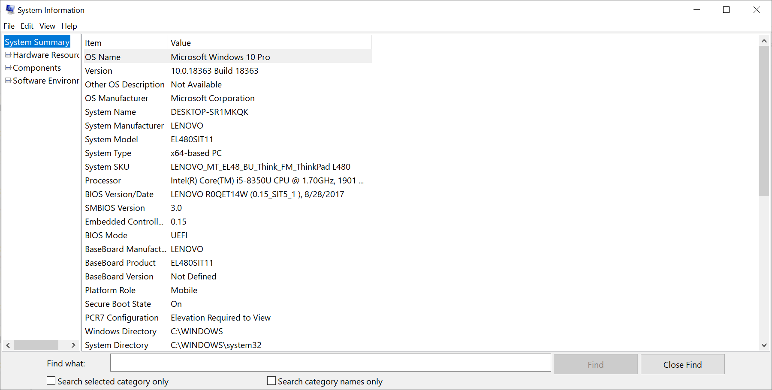
How to submit lab assignments?
Lab Instructions

Slide 9
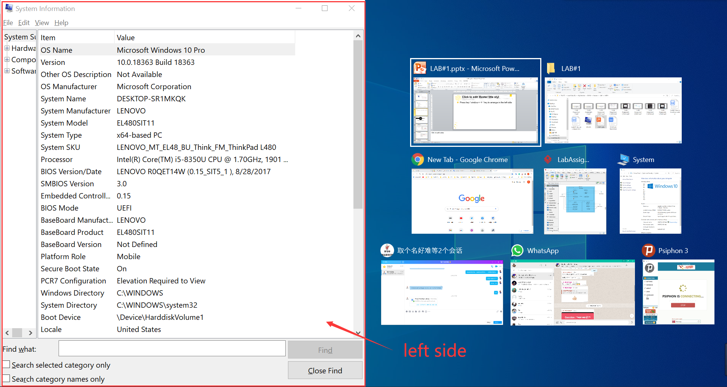
How to submit lab assignments?
Lab Instructions
Step 2:Press key “window + ←” key to arrange system info in the left side
第2步：按“ window + ←”键在左侧排列系统信息

Slide 10
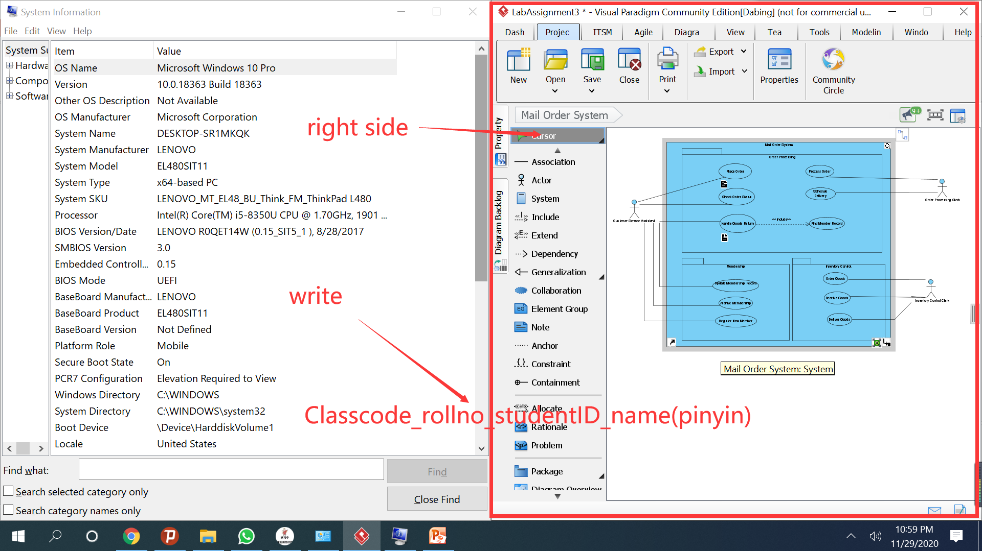
How to submit lab assignments?
Lab Instructions
Step 3:Press key “window + →” key to arrange virtual paradigms in the right side
第三步：按“ window + →”键在右侧排列虚拟范例
Class | Class code
软件(测试Test)2019年-1 | TEST1
软件(网络 Net)2019年-1 | NET1
软件(网络 Net)2019年-12 | NET2
软件(移动开发Mob)2019-1 | MOB1
软件(移动开发Mob)2019-2 | MOB2
软件(移动开发Mob)2019-3 | MOB3
软件(杰普BigData)2019-1 | BIGDATA1
软件(杰普BigData)2019-2 | BIGDATA2
软件(软件开发Dev)2019-1 | DEV1
软件(软件开发Dev)2019-2 | DEV2
软件(软件开发Dev)2019-3 | DEV3
软件(软件开发Dev)2019-4 | DEV4
软件(虚拟现实技术VR)2019-1 | VR1
软件(虚拟现实技术VR)2019-1 | VR2

Slide 11
How to submit lab assignments?
Lab Instructions
Step 4:Must write Class_StudentID_name(pinyin)
必须写Class_StudentID_name(拼音)

Slide 12
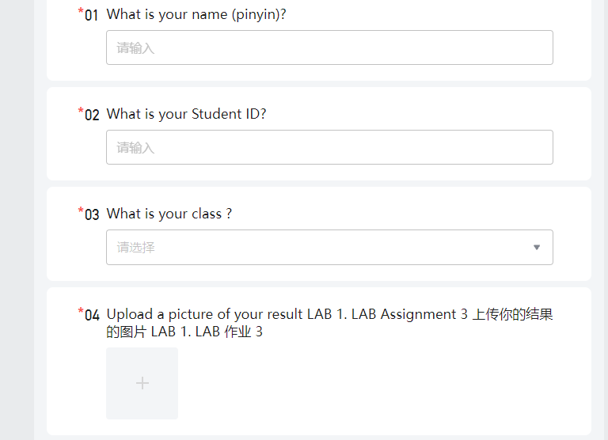



How to submit lab assignments?
Lab Instructions
Step 5: Upload a Screenshot of the result before the Deadline在截止日期前上传结果的屏幕截图
I will share https://docs.qq.com/ file link before end of class
我会在课程结束前分享 https://docs.qq.com/ 文件链接

Slide 13
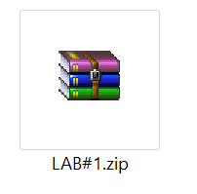
Lab Instructions
LAB#1 -Use Case Modeling
Downloads

Slide 14
No LAB Assignment 1 and 2
没有实验室作业 1 和 2
LAB Assignment 3
Use Case Modeling

Slide 15
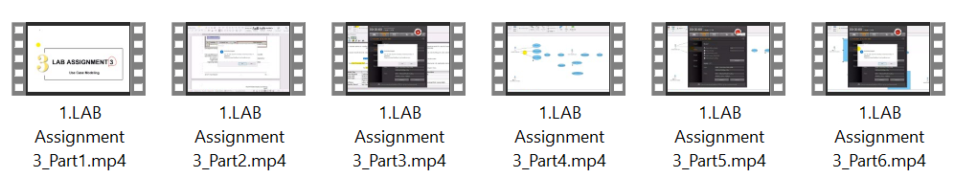
LAB Assignment 3
Use Case Modeling
Watch video

Slide 16
LAB Assignment 3
Use Case Modeling
Objectives:
Familiarize with the concept underlining Use Case Diagram for requirement analysis. Exposure on all elements grouped under UML Case Diagram.
Analyze functional requirements and problem statements of an intended system to be able to translate into use case modeling.
Be able to document use case description and specifications.

Slide 17
LAB Assignment 3
Use Case Modeling
AIM:
Step 1: Prepare the Problem Statement
Step 2: Identify Major Actor(s)
Step 3: Identify Use Cases
Step 4: Create Initial Use Case Diagram
Step 5: Describe Use Cases
Step 6: Perform Textual Analysis
Step 7: Structuring Use Cases with System Boundary

Slide 18

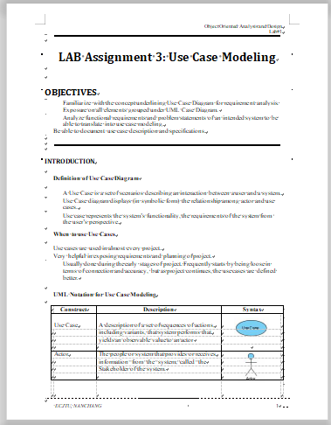
LAB Assignment 3
Use Case Modeling
Design :

Slide 19
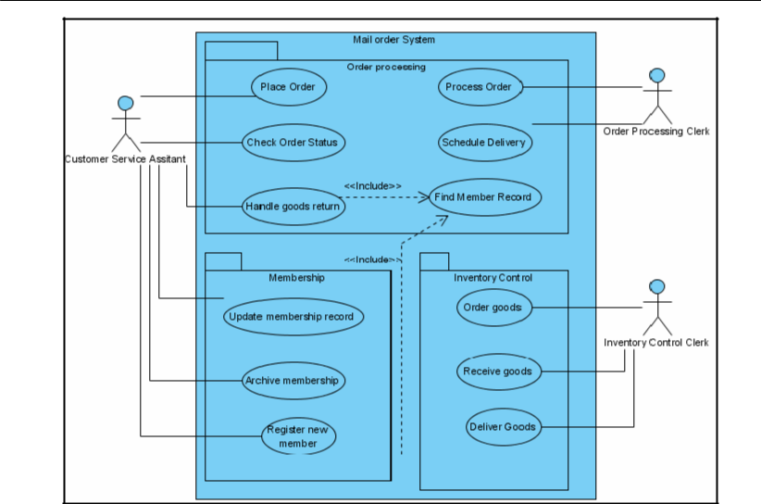
LAB Assignment 3
Use Case Modeling
Result

Slide 20
How to submit lab assignments?
Lab Instructions
Upload a Screenshot of the result before the Deadline在截止日期前上传结果的屏幕截图

Slide 21
The END

